Slide 1
Exploring the Fusion of Computer Vision and Augmented Reality for Enhanced Interactive Learning Experiences
Understanding the intersection of computer vision and augmented reality (AR)
Overview of the importance of interactive learning technologies

Slide 2
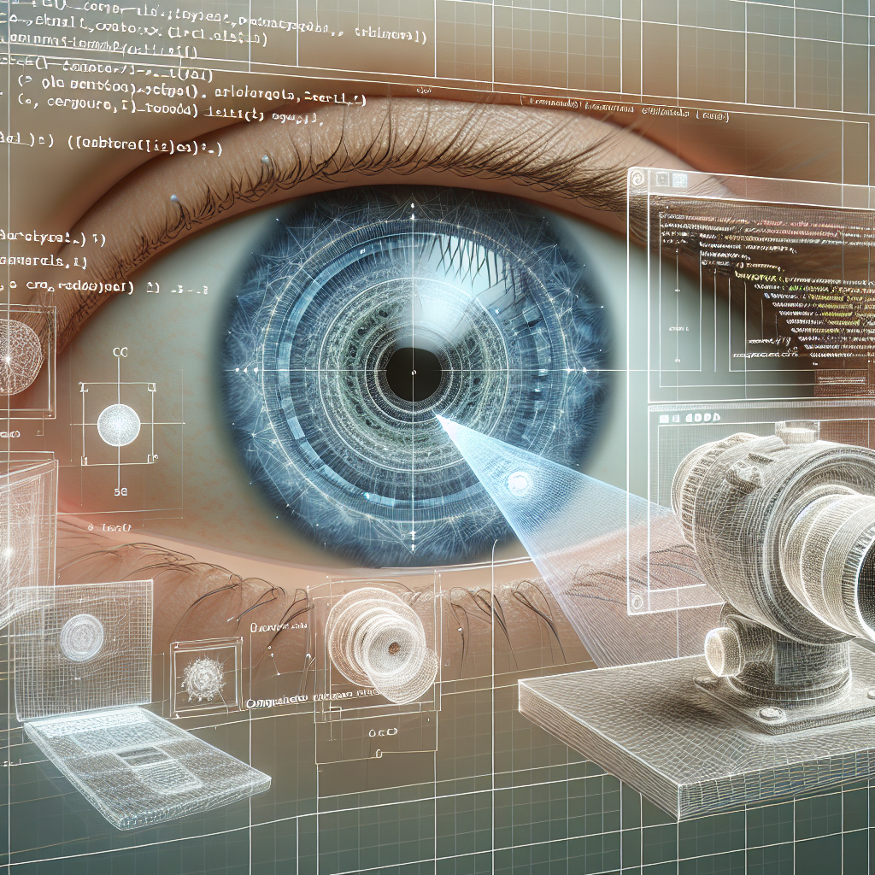
Introduction to Computer Vision
Definition and core principles of computer vision
Key technologies such as image processing, machine learning, and neural networks

Slide 3

Introduction to Augmented Reality
Definition and components of AR
Types of AR: Marker-based, Markerless, Projection-based, and Superimposition-based

Slide 4
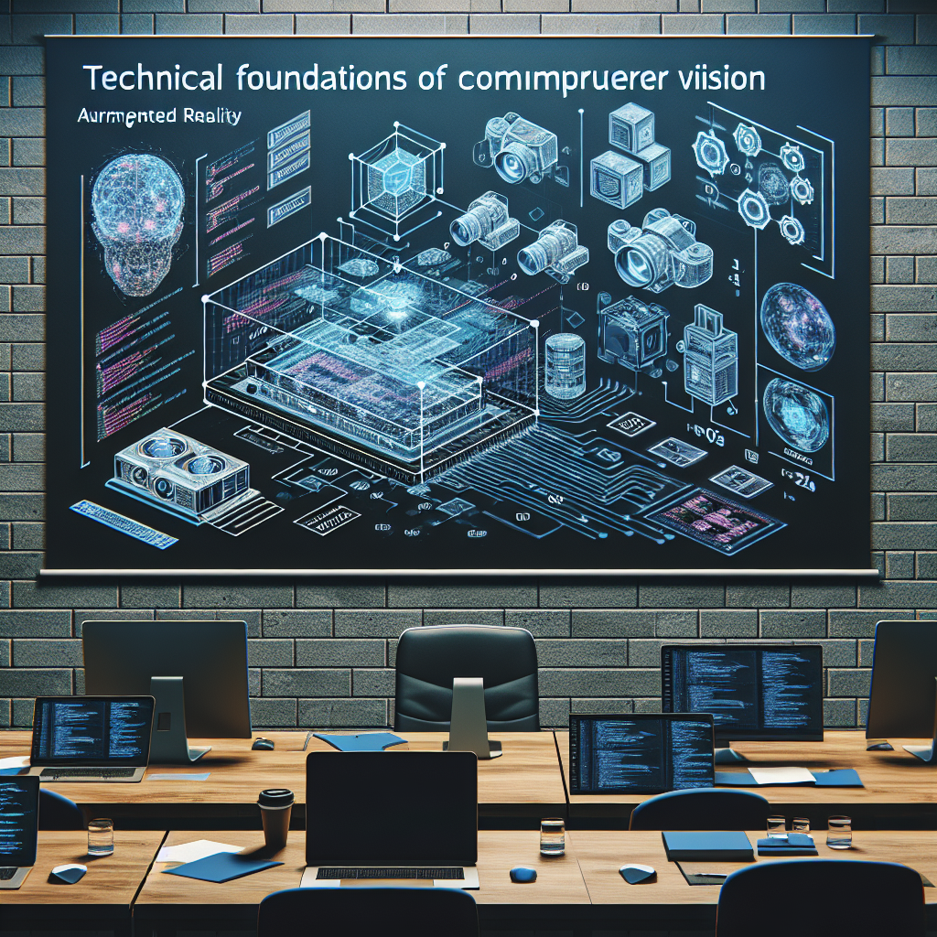
Technical Foundations of Computer Vision in AR
Image recognition algorithms and their role in AR
Real-time data processing and feature extraction techniques

Slide 5
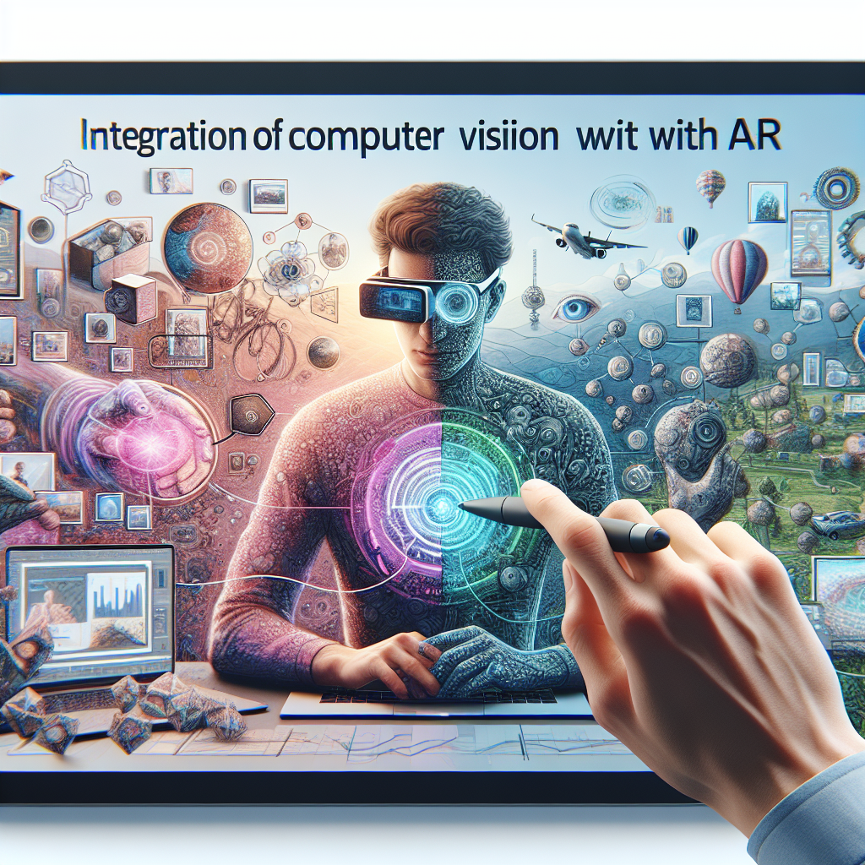
Integration of Computer Vision with AR
How computer vision enhances AR experiences
Use cases in various learning environments, like virtual field trips and simulations

Slide 6

Enhancing Interactive Learning with AR
Benefits of AR in education: Engagement, retention, and accessibility
Examples of AR applications in different subject areas such as biology, history, and engineering

Slide 7
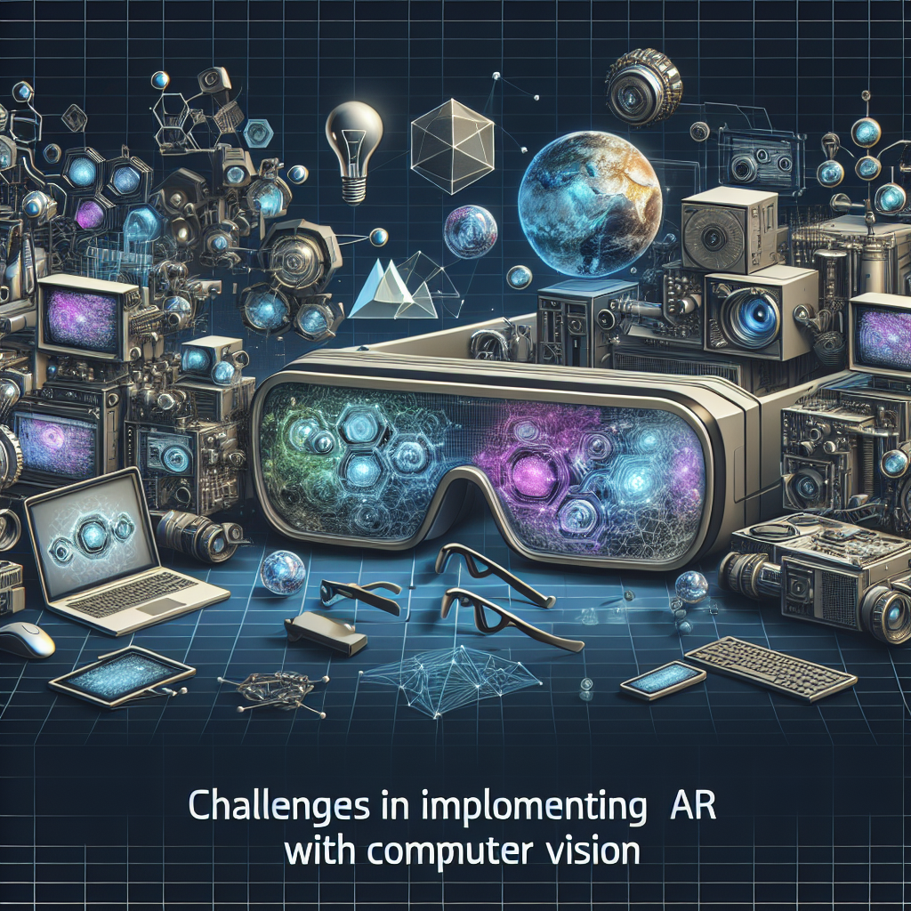
Challenges in Implementing AR with Computer Vision
Technical challenges: latency, software compatibility, device limitations
Pedagogical challenges: aligning with educational outcomes and curricula

Slide 8

Future Trends in Computer Vision and AR for Education
Emerging technologies: AI integration, 5G communication, and edge computing
Potential advancements in personalized learning experiences through adaptive AR

Slide 9

Case Studies: Successful Implementations
Analysis of successful projects or startups using AR and computer vision in education
Impact assessment: Student engagement metrics and learning outcomes

Slide 10

Conclusion and Future Directions
Summary of key points: the significance of the fusion of technologies
Call to action: Encouraging exploration and innovation in educational technologies

